Slide 1


Design and Analysis of Algorithms
Dr. Sajid Iqbal
sajidiqbal.pk@gmail.com
Reference Book
Introduction to Algorithms 3rd Edition By Thomas H. Cormen et. al.
https://mitpress.mit.edu/books/introduction-algorithms-third-edition
COMEDXD

Slide 2
The Heap
Data Structure

Slide 3
Introduction
Tree Data Structure: A data structure that maintains parent-child relationship between data elements
It is a hierarchical data structure
In a tree a data element can have 1 or more children data elements
Types of Tree
Binary Tree: A tree in which each data element can have at most 2 child data elements
N-ary Tree: A tree in which each data element can have at most n child data elements
States of Binary Tree:
Full Binary Tree: A binary tree in which each node has either two children or no child.
Complete Binary Tree: A Binary Tree is complete Binary Tree if all levels are completely filled except possibly the last level
Nearly Complete Binary Tree: A complete binary true with the last level that has all keys as left as possible
Top: Full Binary Tree
Mid: Nearly Complete Binary Tree
Bottom: Complete Binary Tree

Slide 4
Elements of Tree
A point in tree is called the node
A node consists of
Data, pointer to left child, pointer to right child
First node is called the root node
Last nodes are known as Leaf nodes
Root Node
Leaf nodes

Slide 5
The Heap data structure
The heap data structure is an array object that we can view as a nearly complete binary tree
Each node of the tree corresponds to an element of the array.
The tree is completely filled on all levels except possibly the lowest, which is filled from the left up to a point.
An array A that represents a heap is an object with two attributes:
Length: number of elements in an array
Heap size: how many elements are stored (filled) in the array
In figure the array length is 10 and heap-size is 8.
1 | 2 | 3 | 4 | 5 | 6 | 7 | 8

Slide 6
A heap
1
16
2
3
14
10
Tree Properties
No. of nodes=10 Height of tree =3 Parent nodes are on left in array Node height: number of edges on the longest simple downward path from the node to a leaf. Height of node with value 8 is 1. Tree height: the height of the heap to be the height of its root
4
5
6
7
8
7
9
3
8
9
10
2
4
1
16 | 14 | 10 | 8 | 7 | 9 | 3 | 2 | 4 | 1
1 | 2 | 3 | 4 | 5 | 6 | 7 | 8 | 9 | 10
The heap shown as tree structure and as array. Number in circles show the values stored in that node and number above shows the index of that node in the array

Slide 7
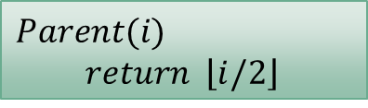

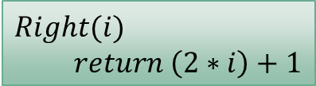
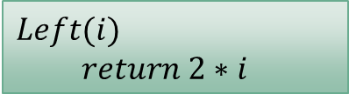
Addressing Nodes
16 | 14 | 10 | 8 | 7 | 9 | 3 | 2 | 4 | 1
1 | 2 | 3 | 4 | 5 | 6 | 7 | 8 | 9 | 10
The root of the tree is first array element i.e. A[1]
If an index i of a node is given, we can find the indexes of parent, left-child and right-child as follows:
Heap Types
Max-heap: A heap in which value of parent is greater than equal to children
Max heap property: For a node i, $A\left[Parent\left[i\right]\right]≥A[i]$.
Min-heap: A heap in which value of parent is less than or equal to children
Min heap property: For a node i, $A\left[Parent\left[i\right]\right]≤A[i]$
Max and min heaps have different applications however the concept is same
$$Parent(i)$$
$$return \left\lfloor i/2\right\rfloor$$
$$Left(i)$$
$return 2∗i$
$$Right(i)$$
$$return \left(2∗i\right)+1$$

Slide 8

Height of heap
Height of Heap: it is the number of edges from root to deepest node.
No. of levels in a tree are defined by depth of tree
For a binary tree of size n, the height of heap is given as
$\left\lfloor \log{n}\right\rfloor →θ\left(logn\right)$
Basic operations on heap take $O(logn)$
Elements | Height of Heap
1 | 0
2 | 1
3 | 1
4 | 2
5 | 2
6 | 2
7 | 2
8 | 3

Slide 9
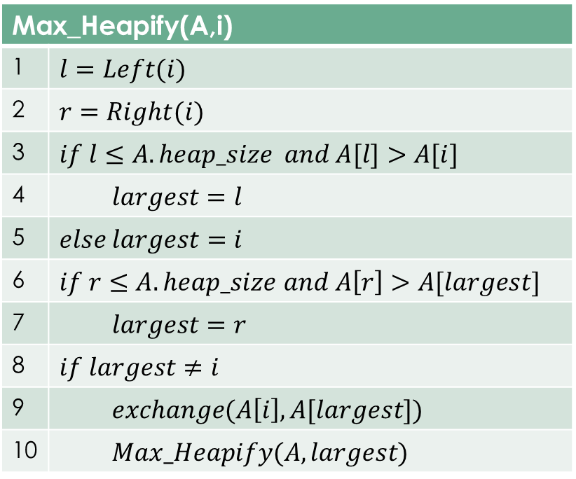

Maintaining Heap Property
Max heap property: For a node i, $A\left[Parent\left[i\right]\right]≥A[i]$.
To define algorithm to maintain max-heap property, we define a procedure named $Max_Heapify(A,i)$
$Max_heapify$assumes that the binary trees rooted at $Left[i]$ and $Right[i]$ are maxheaps, but that $A[i]$ might violate the max-heap property.
$Max_Heapify$lets the value at $A[i]$ “float down” in the max-heap so that the subtree rooted at index $i$ obeys the max-heap property.
Max_Heapify(A,i)
1 | $$l=Left(i)$$
2 | $$r=Right(i)$$
3 | $$if l≤A.heap_size and A[l]>A[i]$$
4 | $$largest=l$$
5 | $$else largest=i$$
6 | $if r≤A.heap_size$ $and A\left[r\right]>A[largest]$
7 | $$largest=r$$
8 | $$if largest≠i$$
9 | $$exchange(A\left[i\right], A[largest])$$
10 | $$Max_Heapify(A,largest)$$

Slide 10
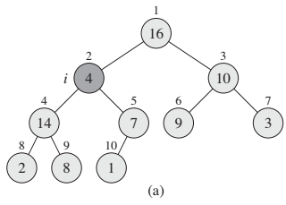
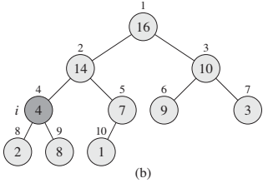
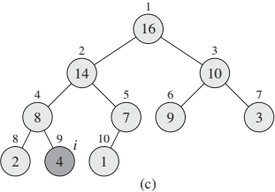
A[2] at node i = 2 violating the max-heap property
It is first exchanged with 14 and then exchanged with 8

Slide 11
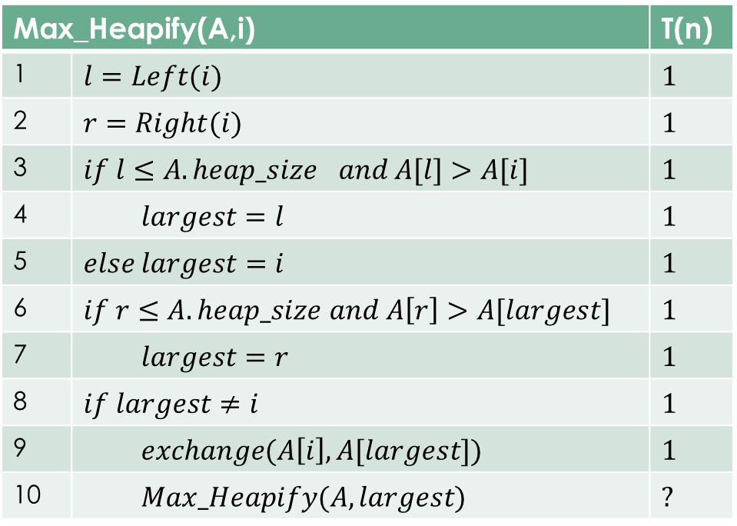

Max_Heapify Time Complexity
Time to fix one element: $θ(1)$
Time to maintain the $max⁡_heap$property on a subtree rooted at one of the children of node $i$.
The children’s subtrees each have size at most $\frac{2n}{3}$ (the worst case)
$T(n)=T(2n/3)+θ(1)$
By case 2 of the master theorem
$T\left(n\right)=O\left(logn\right)=O(h)$
Max_Heapify(A,i) |  | T(n)
1 | $$l=Left(i)$$ | $$1$$
2 | $$r=Right(i)$$ | $$1$$
3 | $$if l≤A.hea{p_size}_{}and A[l]>A[i]$$ | $$1$$
4 | $$largest=l$$ | $$1$$
5 | $$else largest=i$$ | $$1$$
6 | $if r≤A.heap_size$ $and A\left[r\right]>A[largest]$ | $$1$$
7 | $$largest=r$$ | $$1$$
8 | $$if largest≠i$$ | $$1$$
9 | $$exchange(A\left[i\right], A[largest])$$ | $$1$$
10 | $$Max_Heapify(A,largest)$$ | $$?$$

Slide 12
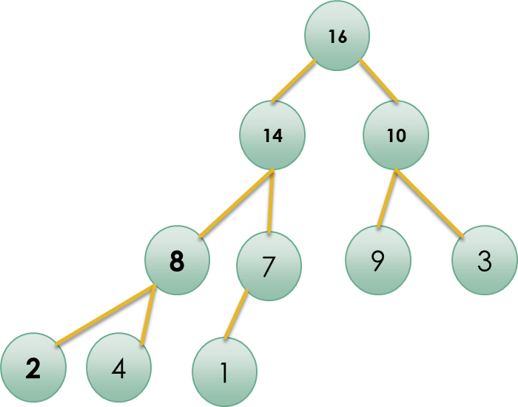
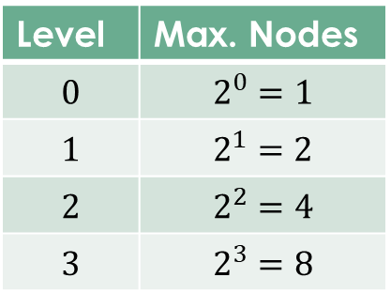

Sub-Tree sizes
Consider a nearly complete sub-tree (heap)
Height of heap = Maximum no. of edges from root to leaf
No. of nodes in complete binary tree of height $h=2^h−1$
i.e. for a tree of height 3, no. of nodes are $7=2^3−1$
Worst case of $Max_heapify$occurs when we recurse from root to leaf.
This recursion may decide to go to left or right at any node
Worst case occurs when
left subtree is complete binary tree of height$h$
Right subtree is complete binary tree or height $h−1$
It means heap last level is half full
No. of nodes in heap are $1+(2^{h}−1)+(2^{h−1}−1)$
Level | Max. Nodes
$$0$$ | $$2^{0}=1$$
$$1$$ | $$2^{1}=2$$
$$2$$ | $$2^{2}=4$$
$$3$$ | $$2^{3}=8$$

Slide 13

Worst case of recurrence
Let $L=sizeof\left(left−subtree\right) R=sizeof\left(right−subtree\right)$
Normally $n≈L+R$
As left has almost double elements than right sub-tree then
$n=2R+R$
$n=3R$
$R=\frac{n}{3}$ and $L=2R=\frac{2n}{3}$

Slide 14
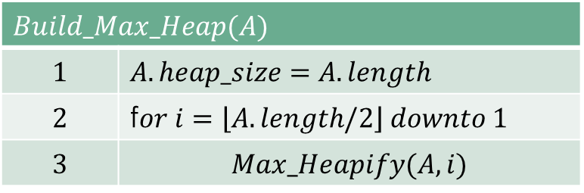

Building a Heap
$Max_heapify$ can be used to build a heap in bottom up manner
If there are n-elements in the heap then $A[\left\lfloor \frac{n}{2}\right\rfloor +1]$ last elements of the array will correspond to leaves.
All blues are leave nodes
So each such leaf can be considered as 1-element heap
$$Build_Max_Heap(A)$$
$$1$$ | $$A.heap_size=A.length$$
$$2$$ | f$or i=\left\lfloor A.length/2\right\rfloor downto 1$
$$3$$ | $$Max_Heapify(A,i)$$

Slide 15
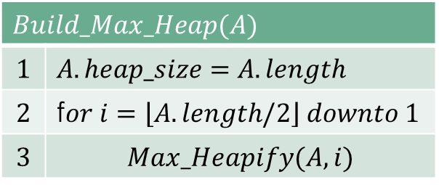

Building Max-heap
Loop Invariant:
At the start of each iteration of the for-loop of lines $2−3$, each node $i+1, i+2,…n$is the root of max-heap
A loop invariant follows mathematical induction
Initialization (base case): Prior to the first iteration of the loop $i=\left\lfloor \frac{n}{2}\right\rfloor .$Each node $\left\lfloor \frac{n}{2}\right\rfloor$+1, $\left\lfloor \frac{n}{2}\right\rfloor +2, . . . , n$ are roots of trivial max-heap
Maintenance: Each iteration maintains the loop invariant.
Children of node I are numbered higher than I and are roots of max-heap
MAX-HEAPIFY(A, i) makes node i a max-heap root of its children(for nodes 2i and 2i+1)
MAX-HEAPIFY call preserves the property that nodes i + 1, i + 2,…, n are all roots of max-heaps
Decrementing I in for-loop re-establishes the for loop for next iteration
$$Build_Max_Heap(A)$$
$$1$$ | $$A.heap_size=A.length$$
$$2$$ | f$or i=\left\lfloor A.length/2\right\rfloor downto 1$
$$3$$ | $$Max_Heapify(A,i)$$
Time Complexity = O(n)

Slide 16
Building Max-heap
Termination: At termination, i = 0. By the loop invariant, each node 1, 2,…,n is the root of a max-heap. In particular, node 1 is.
1 | 2 | 3 | 4 | 5 | 6 | 7 | 8 | 9 | 10
4 | 1 | 3 | 2 | 16 | 9 | 10 | 14 | 8 | 7
2
16
3
14
16
9
10
14
8
7
9
10
14
8
7
9
10
2
8
7
16
14
16
9
10
14
8
7
9
10
2
8
7

Slide 17
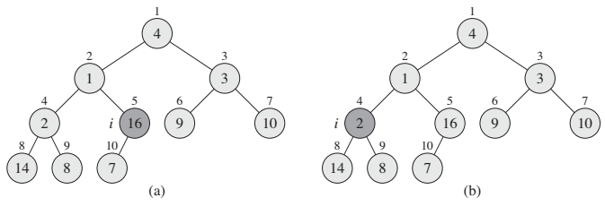
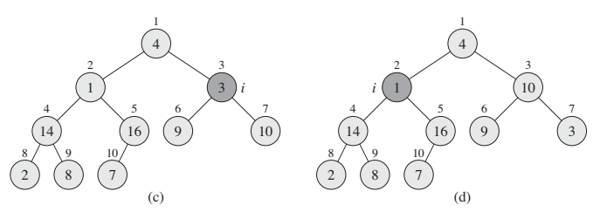
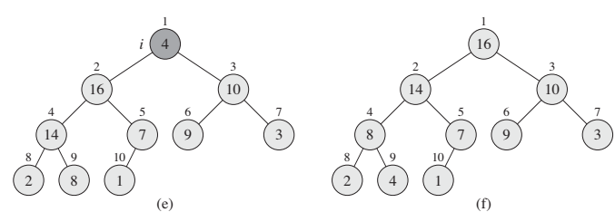
1 | 2 | 3 | 4 | 5 | 6 | 7 | 8 | 9 | 10
4 | 1 | 3 | 2 | 16 | 9 | 10 | 14 | 8 | 7
[16 14 9 10 8 1 4 2 3 7]
[1 2 3 4 5 6 7 8 9 10]

Slide 18
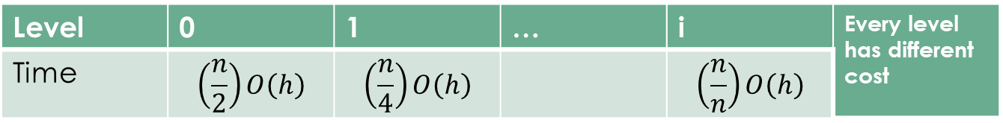


Time Complexity of Build Heap
$T\left(n\right)=\sum_{0}^{logn}{\left\lceil \frac{n}{2^{h+1}}\right\rceil O\left(h\right)}$
$T\left(n\right)=O(n\sum_{0}^{logn}{\left\lceil \frac{h}{2^{h}}\right\rceil ) }$
$T\left(n\right)=O(n\sum_{0}^{∞}{\frac{h}{2^{h}}) }=n\sum_{0}^{∞}{h2^{−h} }$
$\sum_{0}^{∞}{kx^{k}=\frac{x}{(1−{x)}^{2}}} So$
$n\sum_{0}^{∞}{h{(\frac{1}{2})}^{h} }=\frac{\frac{1}{2}}{{\left(1−\left(\frac{1}{2}\right)\right)}^{2}}=n.2=n$
$O(n)$ (linear time)
T(Max_Heapify)= O(logn)
T(Build_Max_Heap)=O(n)
T(n)=O(nlogn)
There are logn levels in tree
Each level takes O(h) time and height changes
So T(n) at level 0 will be $\left\lceil \frac{n}{2^{h+1}}\right\rceil O\left(h\right)=\left(\frac{n}{2}\right)O\left(h\right)$
Level | 0 | 1 | … | i | Every level has different cost
Time | $$\left(\frac{n}{2}\right)O\left(h\right)$$ | $$\left(\frac{n}{4}\right)O\left(h\right)$$ |  | $$\left(\frac{n}{n}\right)O\left(h\right)$$

Slide 19
Python Implementation
def Max_Heapify(A,i): l=Left(i) r=Right(i) if(l<heap_size and A[l]>A[i]): largest=l else: largest=i if(r<heap_size and A[r]>A[largest]): largest=r if (largest!=i): t=A[i] A[i]=A[largest] A[largest]=t Max_Heapify(A,largest)
def Build_Max_Heap(A): global heap_size heap_size=len(A) for i in range(len(A)//2,-1,-1): Max_Heapify(A,i) return A # Driver Code A=np.asarray([4,1,3,2,16,9,10,14,8,7]) print(A) A=Build_Max_Heap(A) print(A)
import numpy as np def Parent(i): return i//2 def Left(i): return 2*i def Right(i): return 2*i+1 heap_size=0 largest=0
2
3
1

Slide 20

Thanks for watching
Dr. Sajid Iqbal
Assistant Professor
Department of Computer Science
Bahauddin Zakariya University, Multan
sajidiqbal.pk@gmail.com
YouTube Channel: COMEDXD
Allah Hafiz

